Slide 1
Homework 2 – parameter estimation
Yi Chen
Feb. 24 2020

Slide 2
Overview
System setup
Plant 1 without PE
Plant 1 with PE
Plant 2 without PE
Plant 2 with PE

Slide 3
Setup

Slide 4
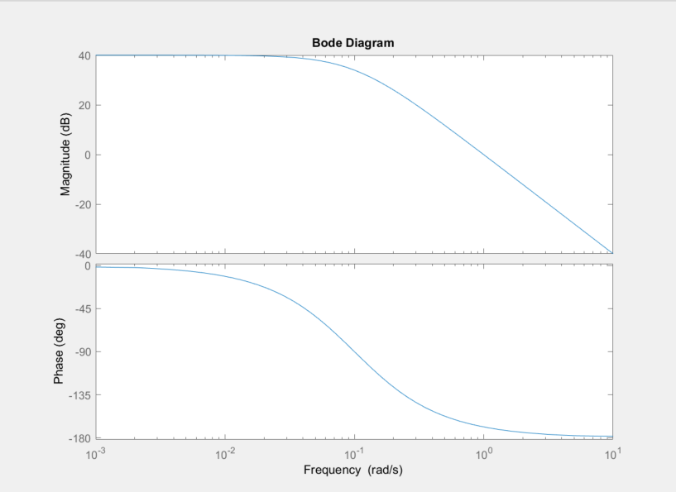
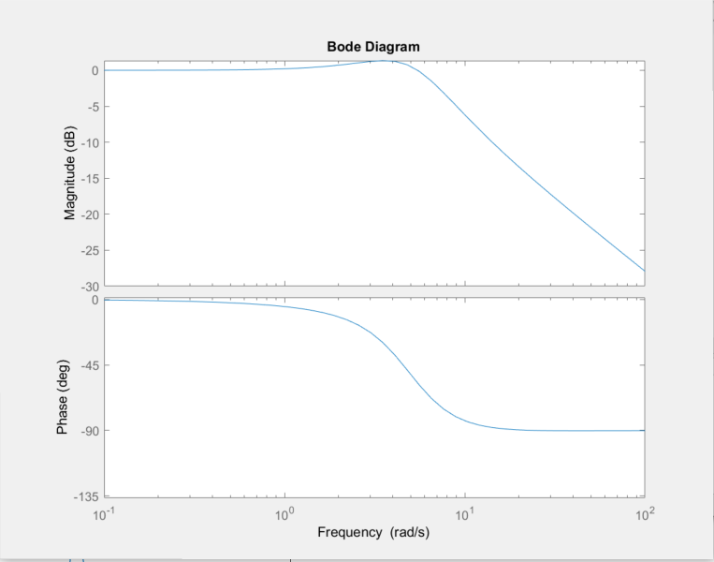
Bode plot
We used Bode plot to check the frequency response for ideal filter.
Plant 1
Plant 2

Slide 5
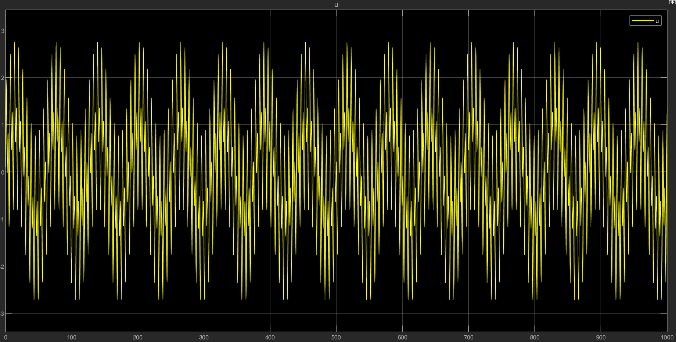
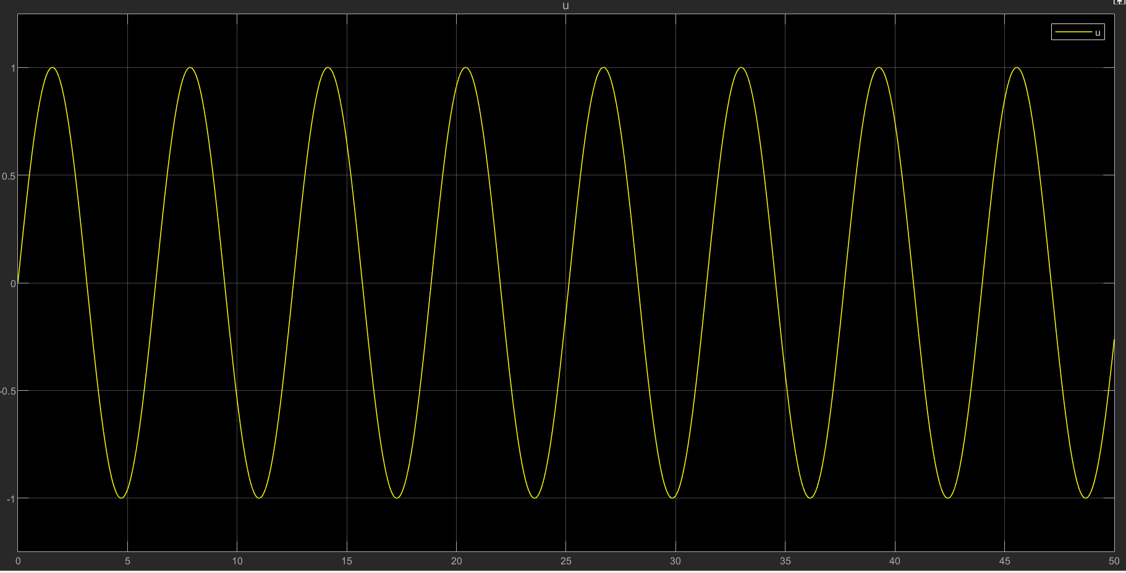
Inputs
We compare a non-PE to a PE input
PE input: combination of sine wave at frequency of 0.1, 1, 2Hz
Non-PE input: sine wave at frequency of 0.1Hz

Slide 6
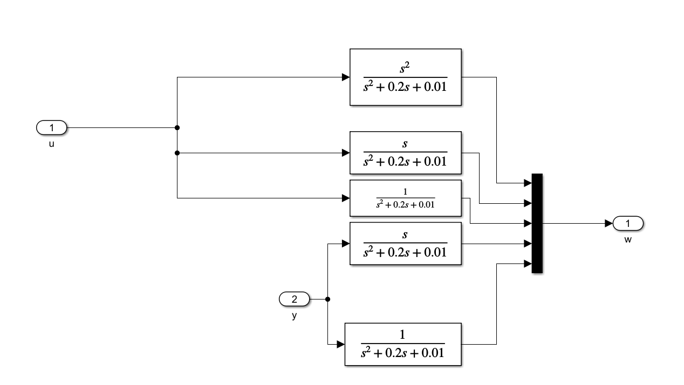
Filter
A good filter would be stabilizing as well as having bandwidth close to the bandwidth of the plant
In this case, we use the denominator of the plant as filter

Slide 7
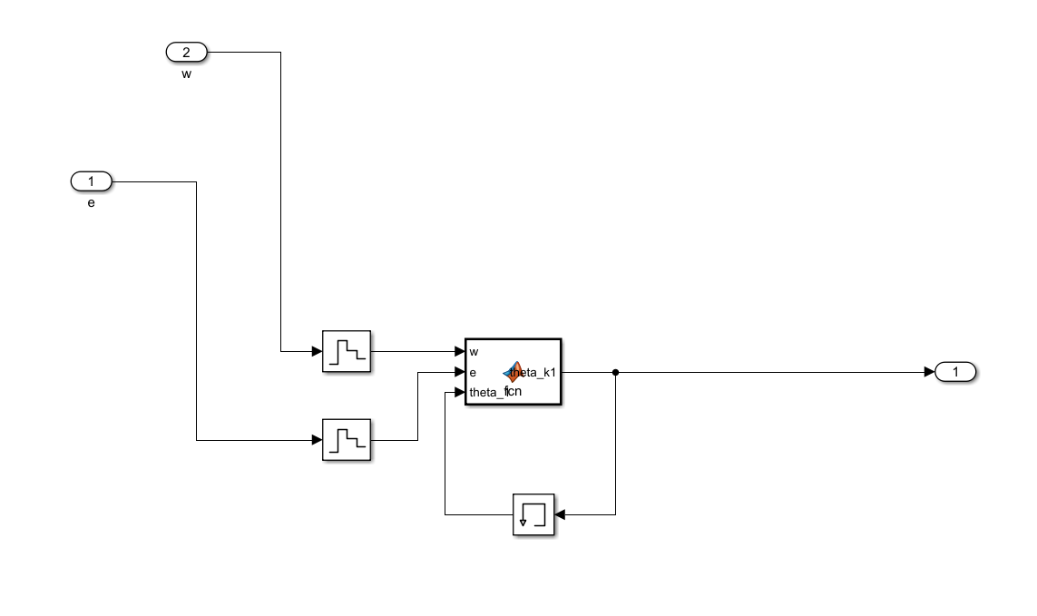
Gradient
We set the initial condition to be very close to actual plant, with 10⁻⁶ and 0.1 difference for plant 1
Initial error is set to 1 for plant 2
Gamma is set to 0.000001 for plant 1, 10 for plant 2
Sampling speed for discrete time system is at 0.01

Slide 8
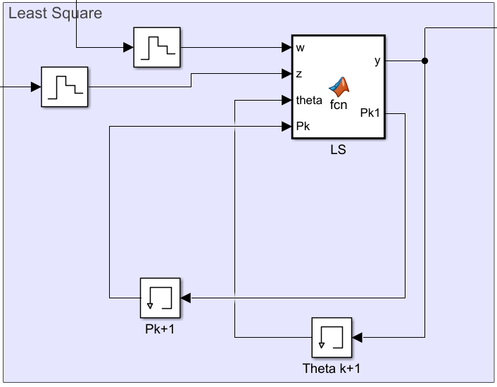
Least square
We set initial values to be all zero
Alpha/gamma is set to 1

Slide 9
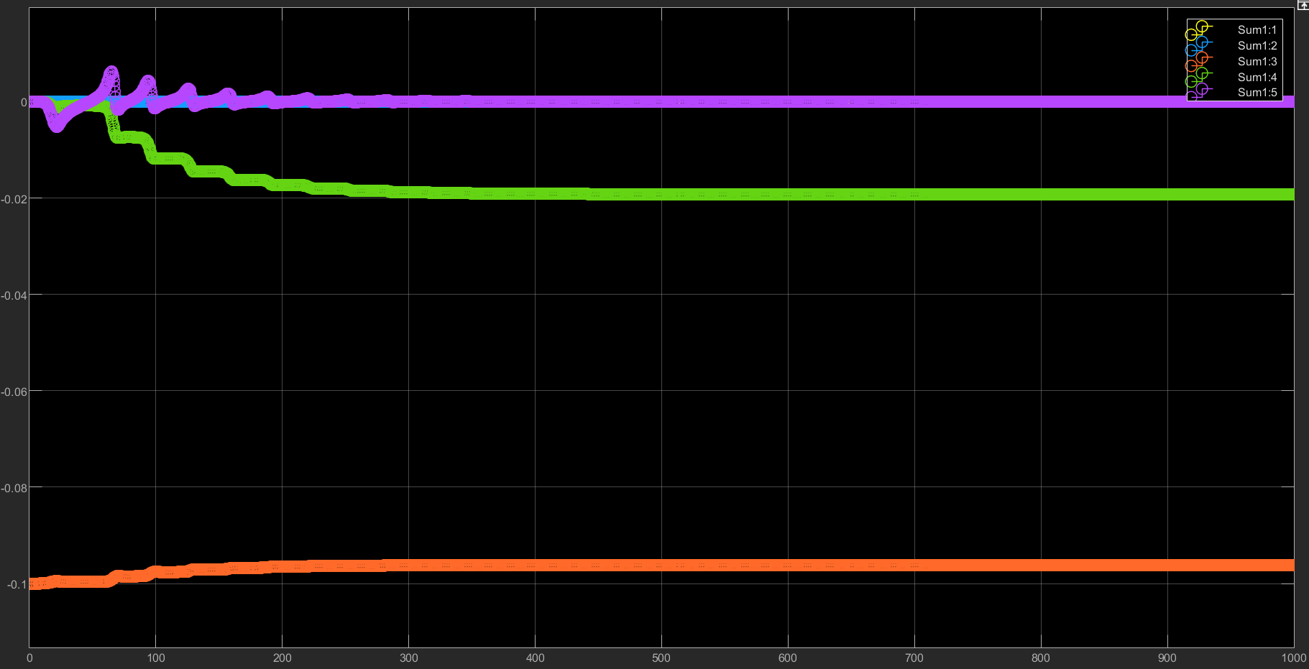
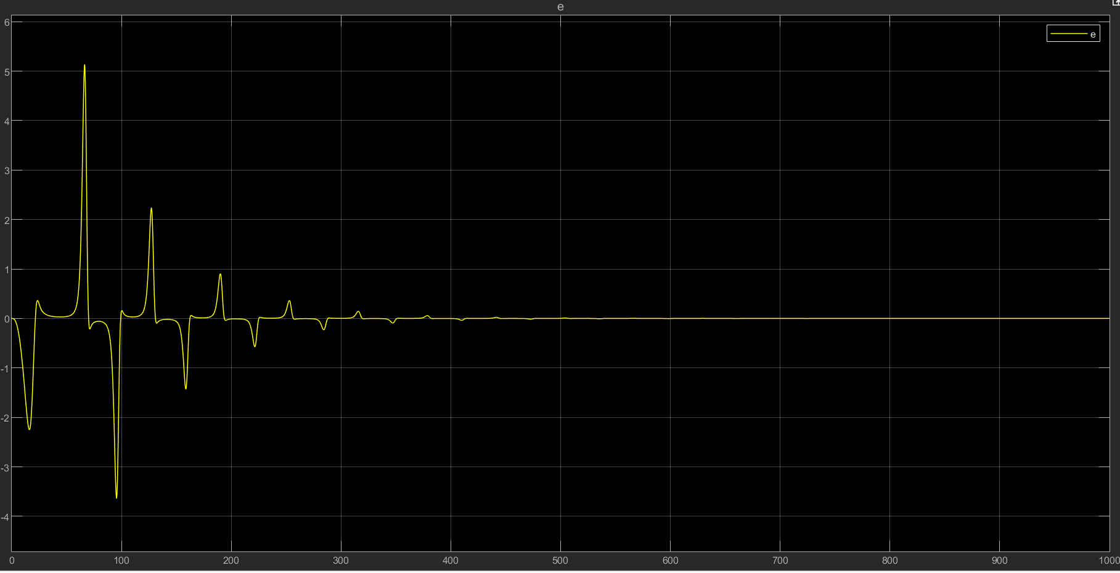
Plant 1 without PE - Gradient

Slide 10
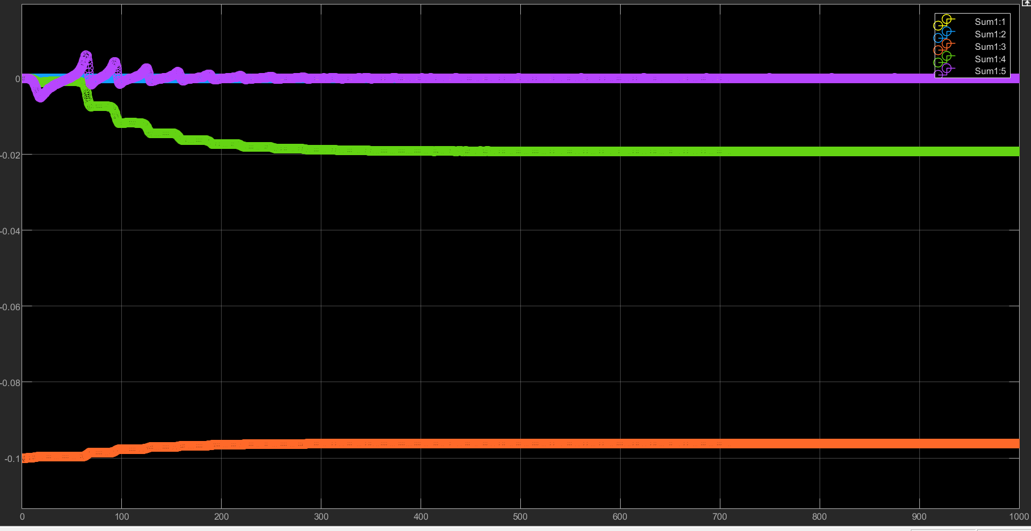
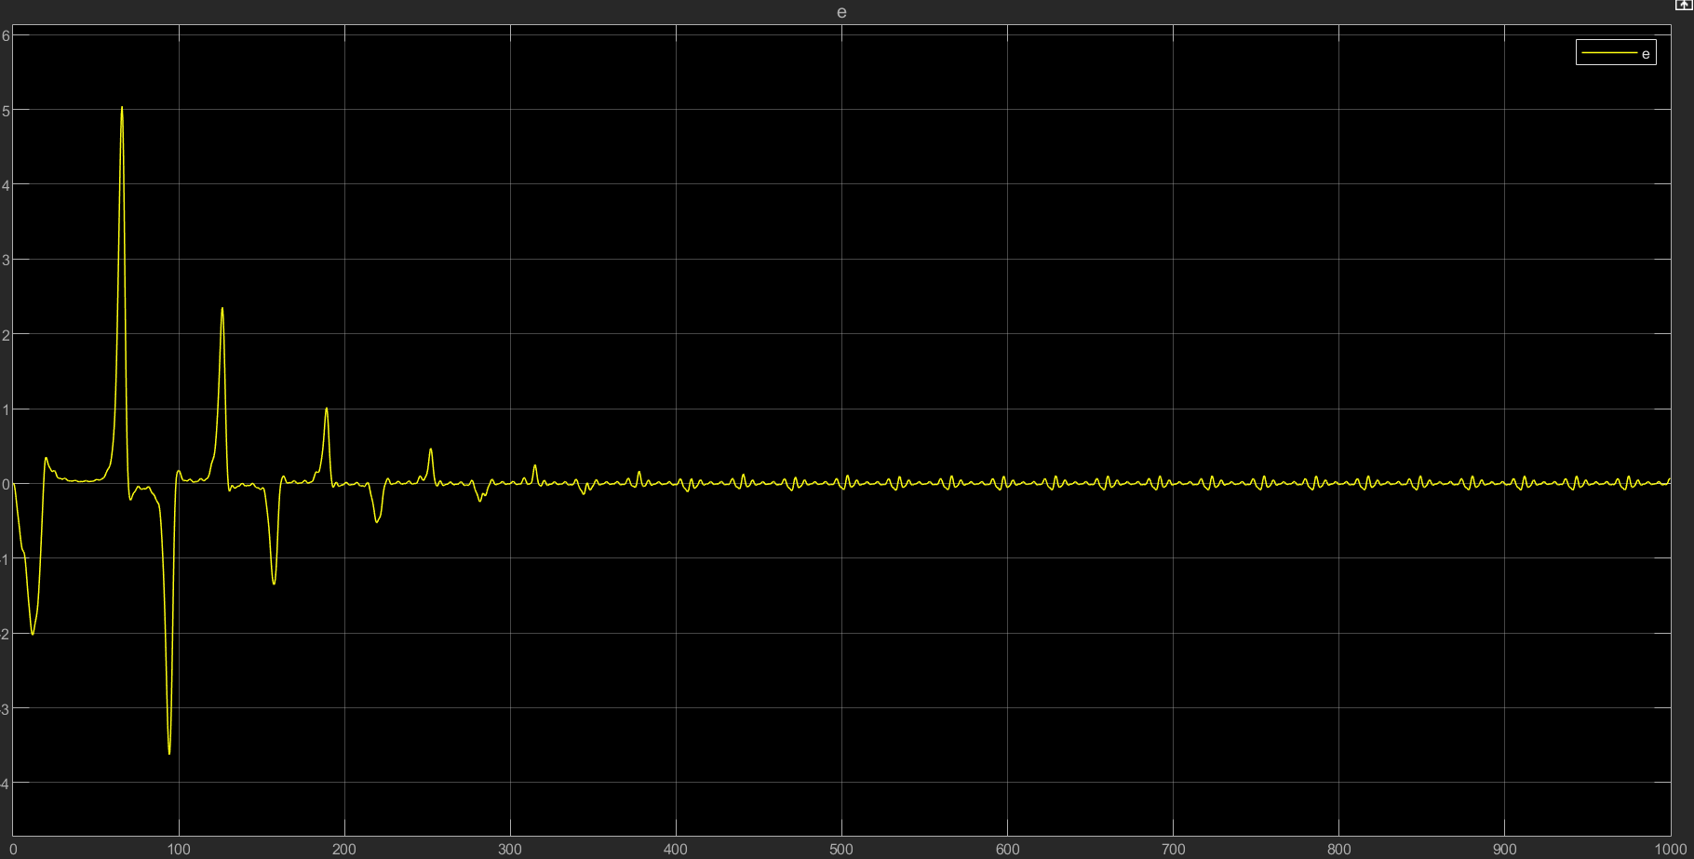
Plant 1 with PE - Gradient

Slide 11
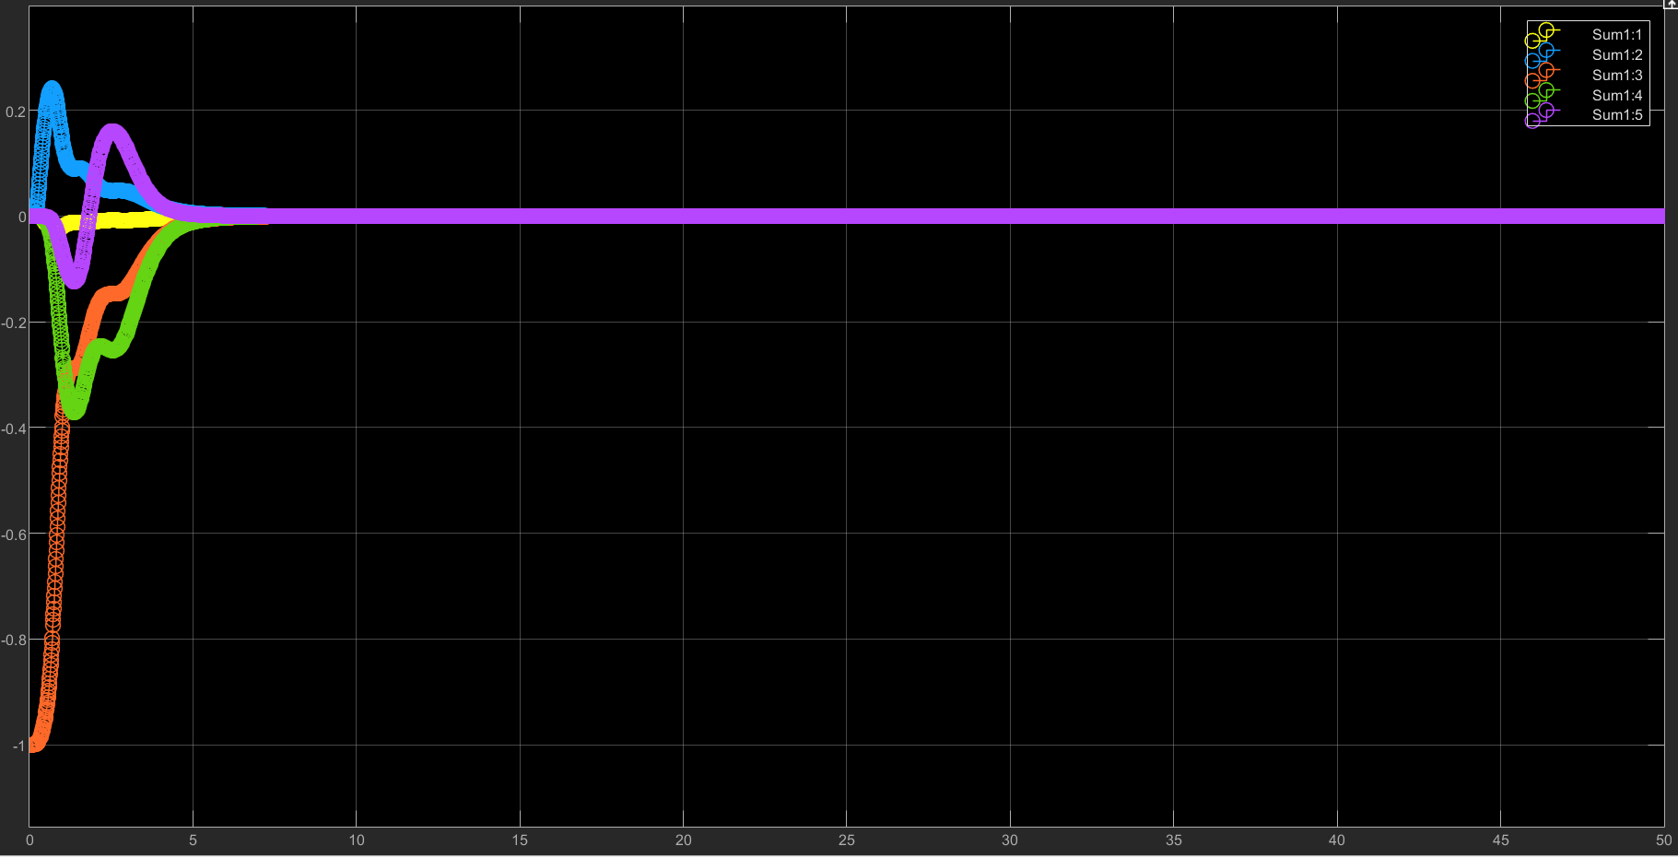
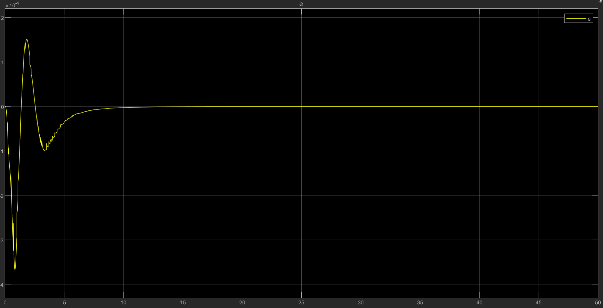
Plant 1 without PE - LS

Slide 12
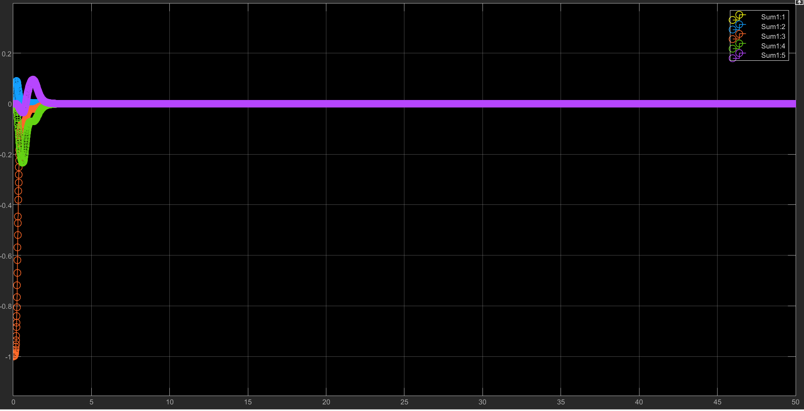
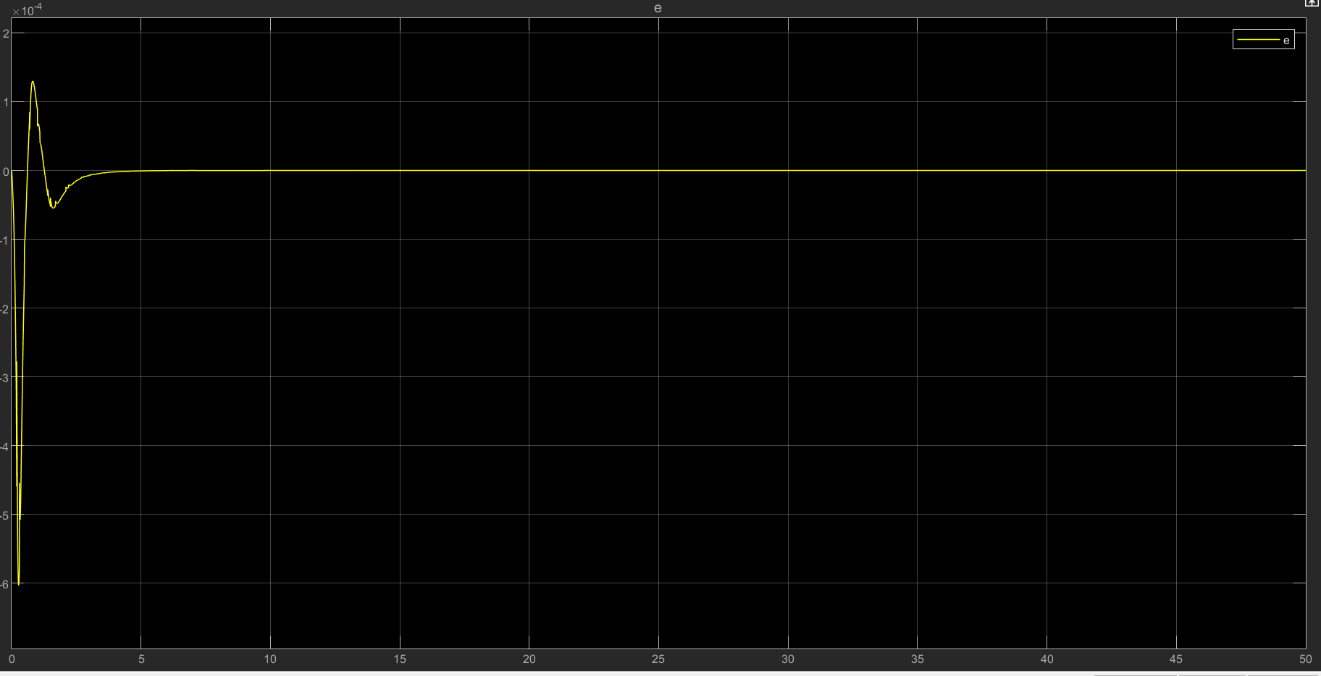
Plant 1 with PE - LS

Slide 13
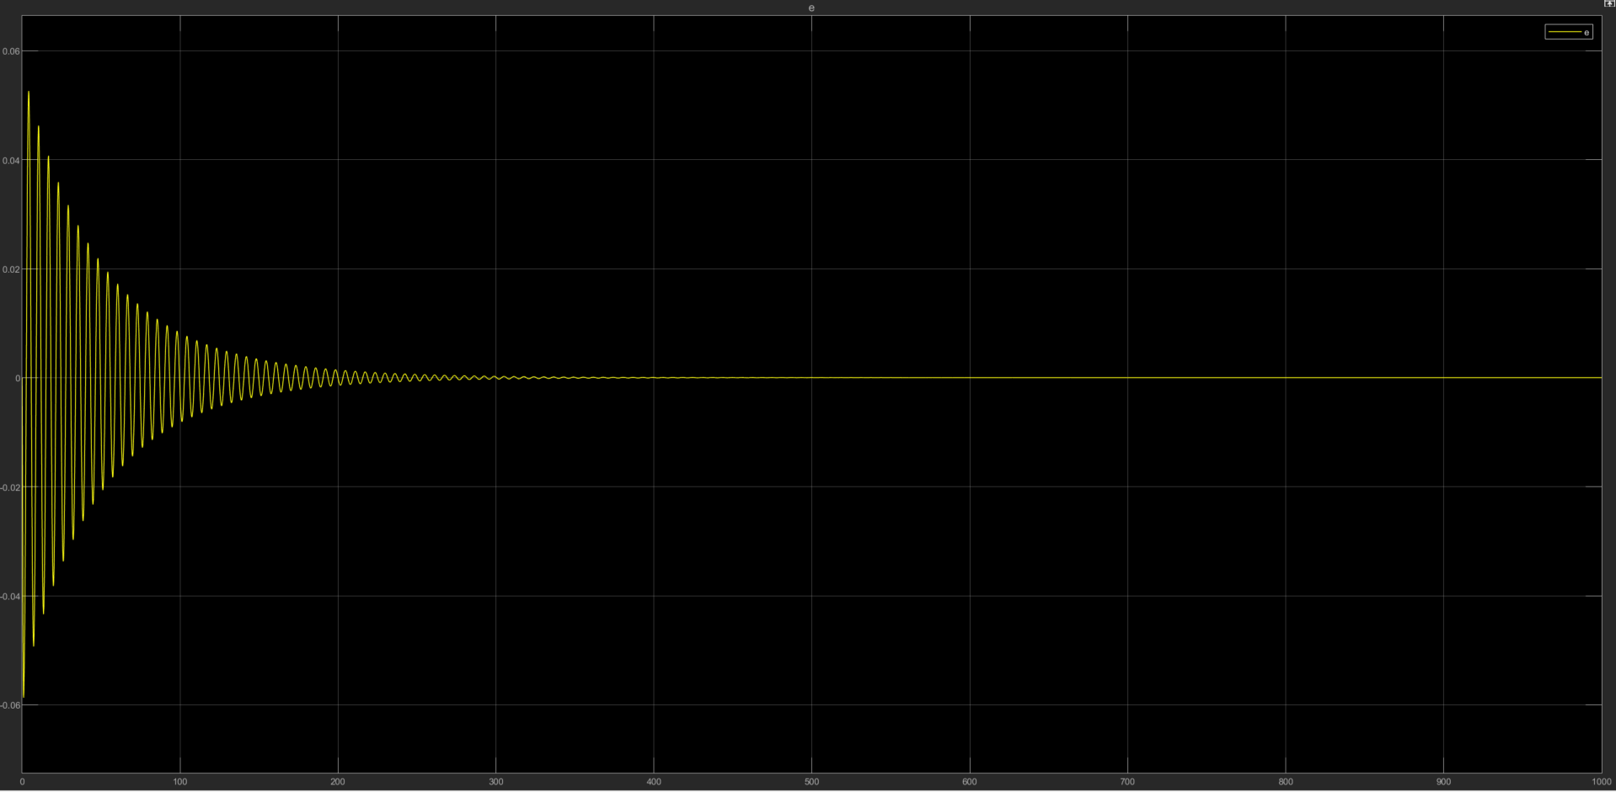
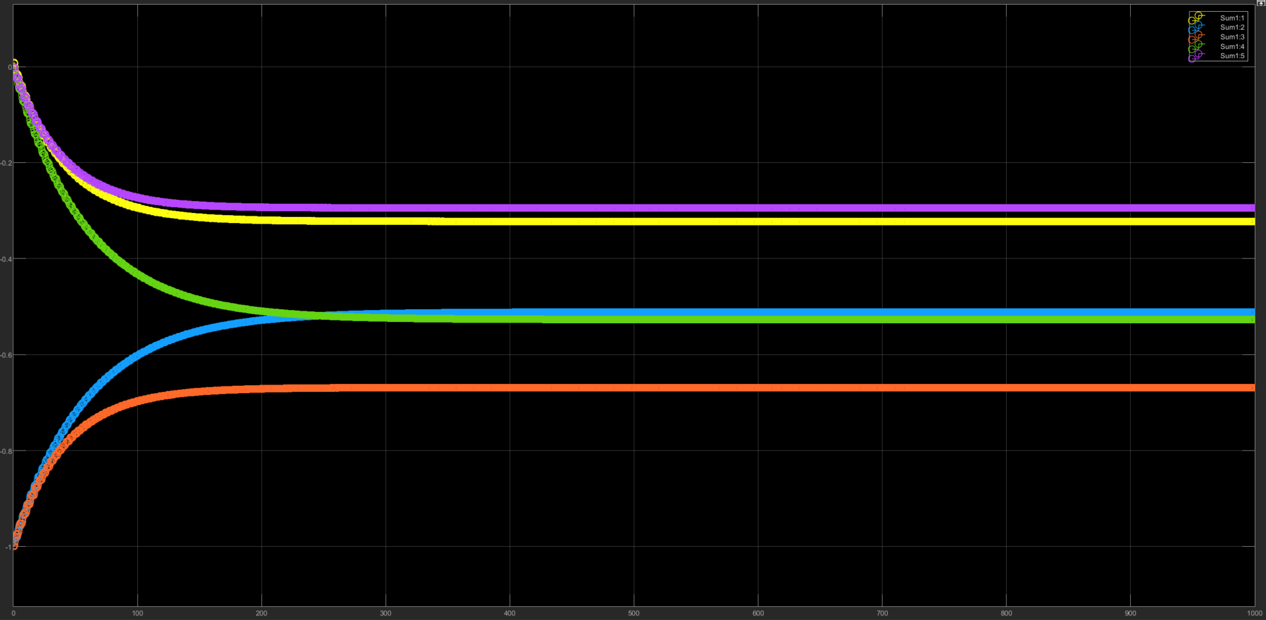
Plant 2 without PE - Gradient
T = 1000s, initial = [0 3 24 0 0]’, gamma = 10

Slide 14
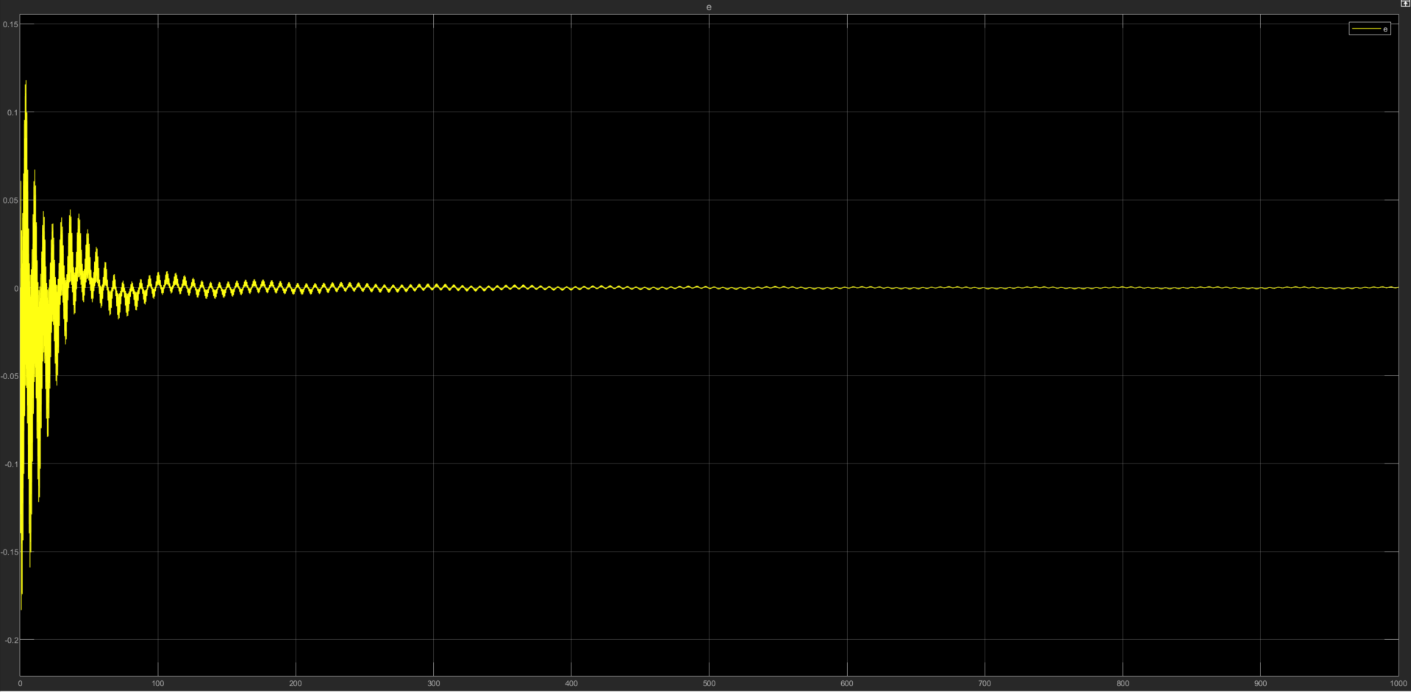
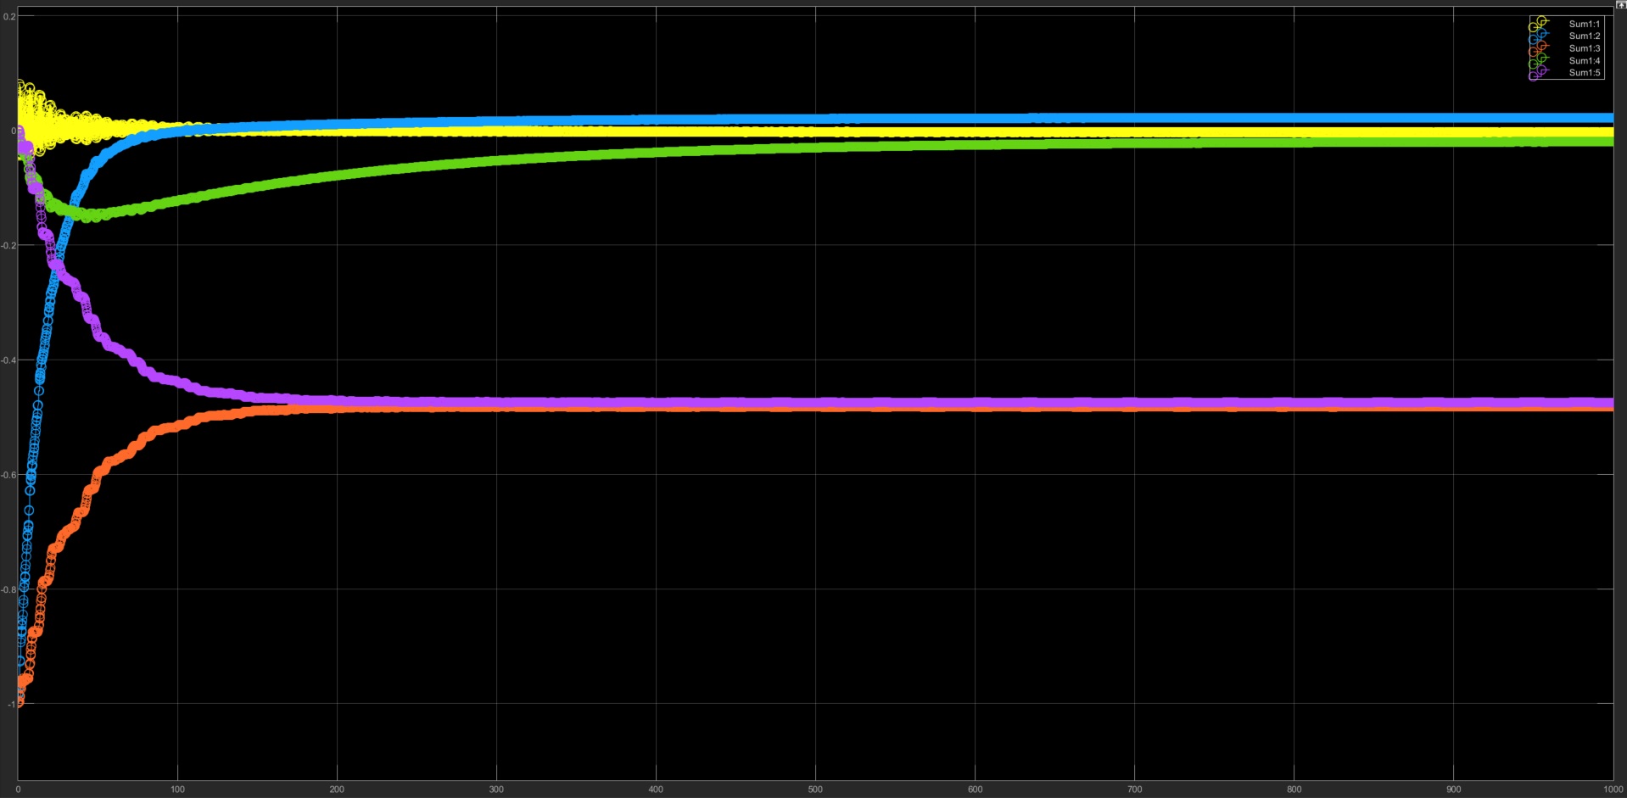
Plant 2 with PE - Gradient
T = 1000s, initial = [0 3 24 0 0]’, gamma = 10

Slide 15
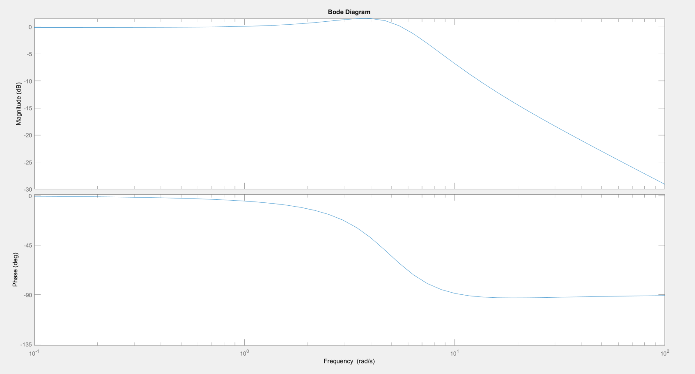
Plant 2 – Gradient – bode plot
Since the parameter error is significant, we performed bode plot analysis to compare the response of 2 systems

Slide 16
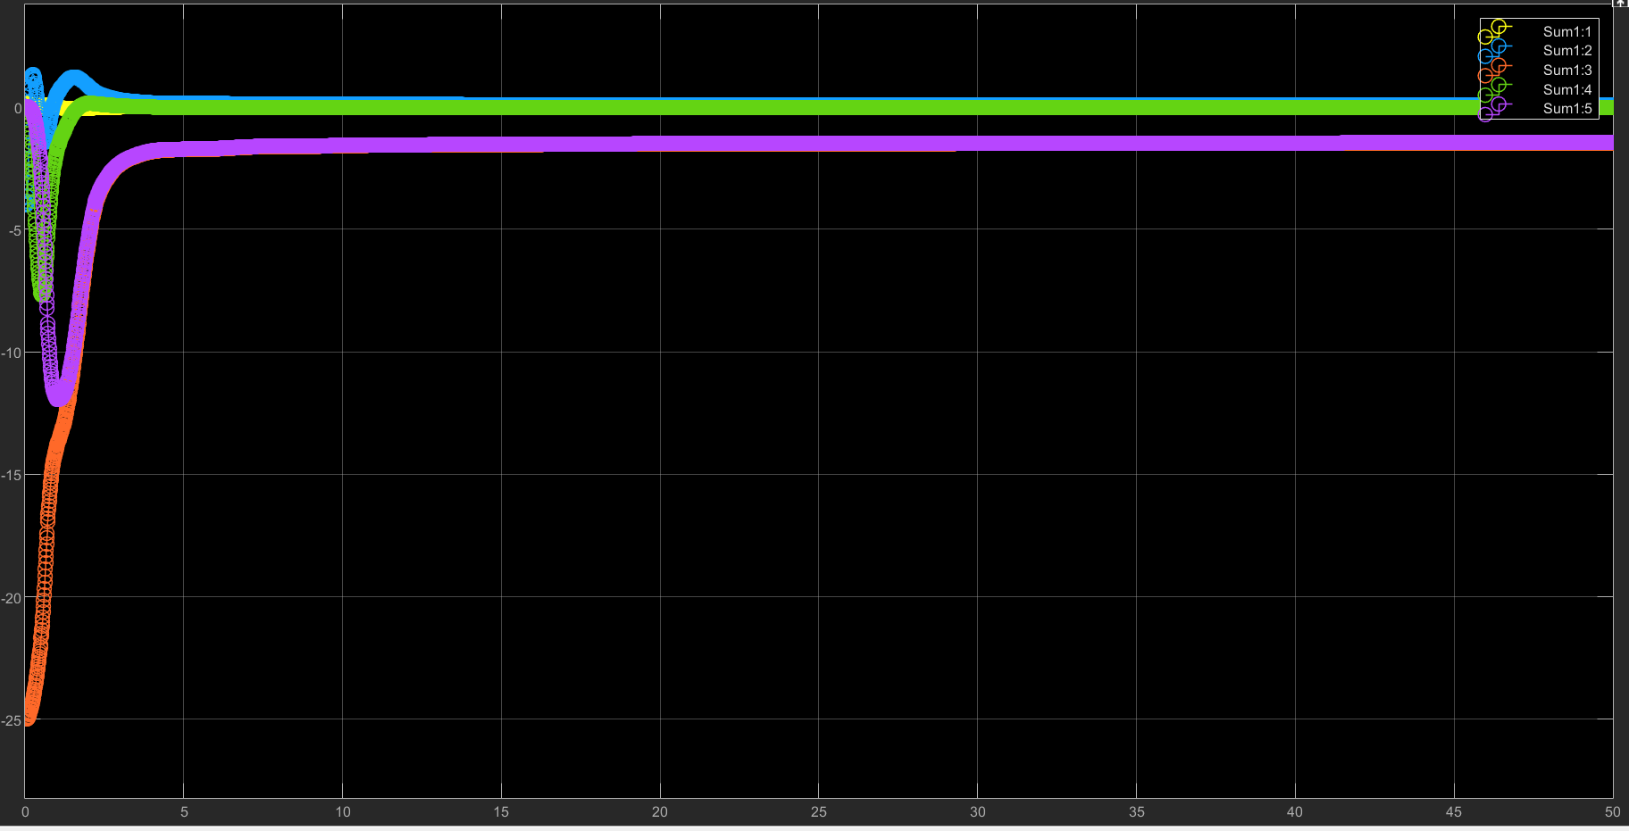
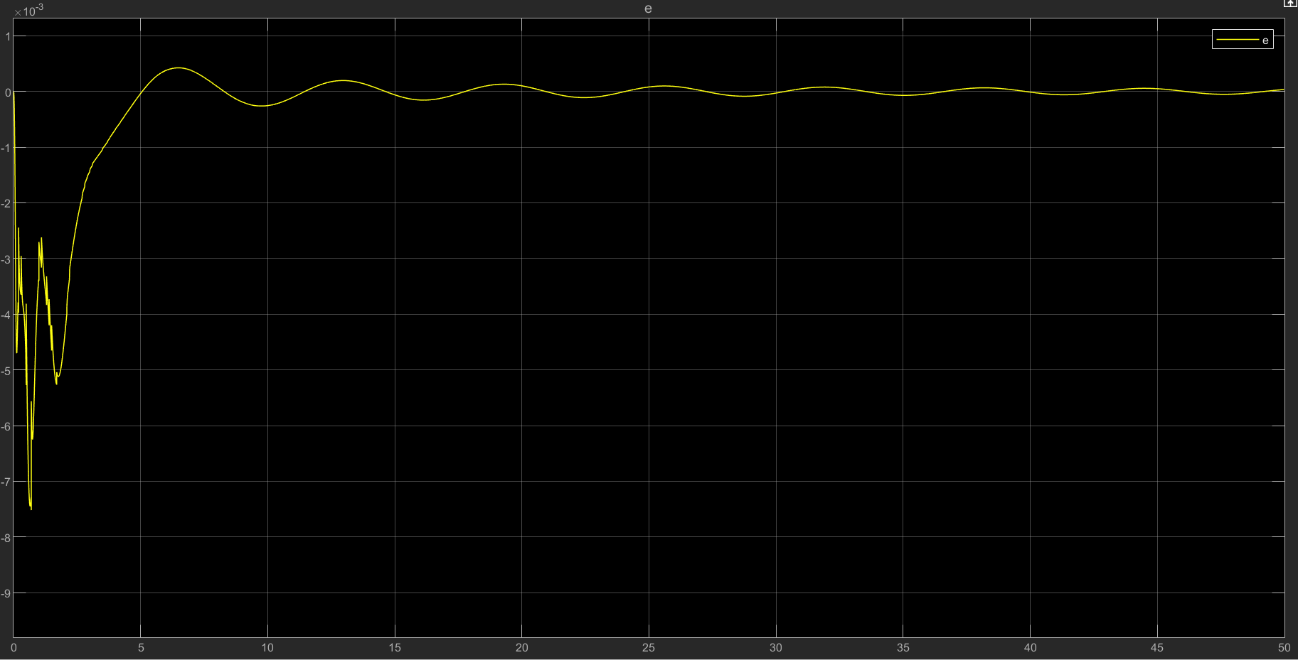
Plant 2 without PE - LS

Slide 17
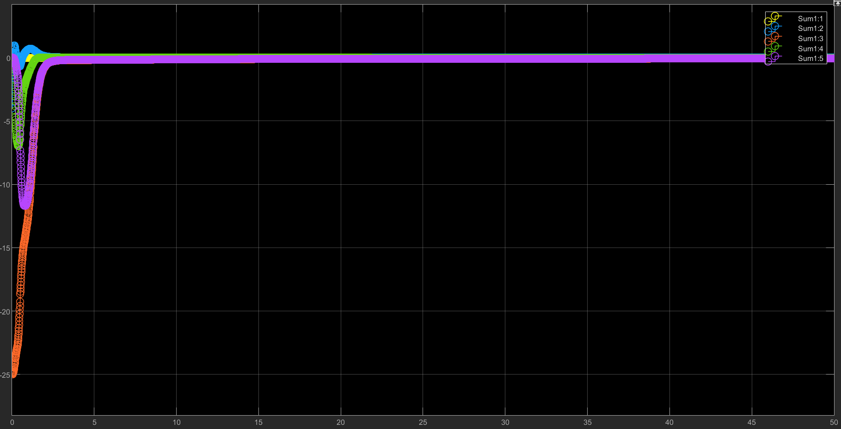
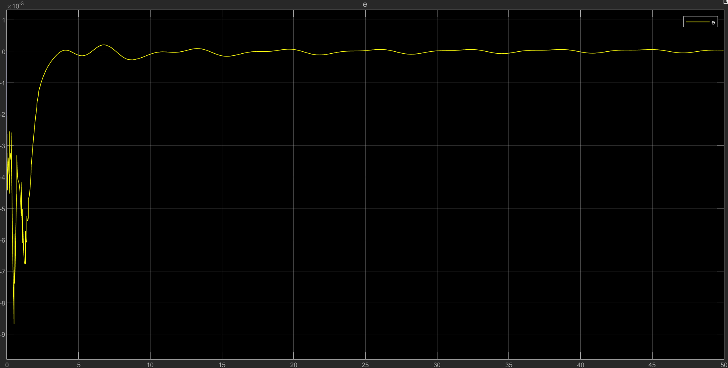
Plant 2 with PE - LS

Slide 18
Summary
In general, LS has better adapting speed than gradient
Given a bigger error in initial condition, LS can adapt to it significantly faster
Persistent excitation helps the estimation to converge to the right value, as seen in the plant 2 with LS

